Slide 1

ECEN 3593-001 Computer Organization
Lecture #3
22 January 2021

Slide 2


Agenda
Class Announcements
Course Structure
Introduction to Computer Architecture

Slide 3
Class Announcements
Reading for the week
“Computer Organization and Design, The Hardware / Software Interface, RISC-V edition,” by David Patterson and John Hennessy
ISBN 978-0-12-812275-4
Chapter 1, “Computer Abstractions and Technology”
sections 1.1 thru 1.2
pages 2-12
Chapter 2, “Language of the Computer”
sections 2.1 thru 2.8
pages 60-108
RISC-V Specification is in the Course Content Area in Canvas
Codasip NDA
Due by end of class today

Slide 4
Class Announcements
Slack – all but 2 people have responded to the invitation
Codasip NDA – everyone has signed the NDA – THANK YOU!
Phase 1 is posted – Target Date Thursday, January 28 at 10:00 PM
Bonus 1%/day before that (maximum 7%)
Deduction 25%/day after that

Slide 5
Codasip Server Environment
Important Beginning Tips
READ THE PHASE DOCUMENT CAREFULLY – it contains all of the information you need
Use standardname format for everything – files and projects
Send a Slack DM when you have submitted

Slide 6
Description and Content
The course material will convey both technical and industry requirements to enable proper engineering architectural decisions as well as implementation.
Topics include:
Instruction Set Architecture
Data path design
CPU control
Evaluating Performance
Memory Management
Memory Hierarchy
Virtual Memory
Caching subsystems
Performance via parallelism
System design
System Hierarchy
High Level Architectural Programming
CodAL

Slide 7
Expected Class Outcome You will be able to …
Develop a CPU data path
Implement a CPU control block
Implement a system level memory hierarchy
Model a processor, memory hierarchy, and subsystems in an integrated development environment
CodAL high level architectural language
Debug a computer architecture cycle accurate processor model
Create a Verification test
Optimize a L1 cache based on end application algorithm and space requirements
Make the proper engineering decisions between energy, performance, and cost

Slide 8

Computer Organization and Design RISC-V Edition 1st Edition The Hardware Software Interface Authors: David Patterson John Hennessy eBook ISBN: 9780128122761 Paperback ISBN: 9780128122754
Required Text Book

Slide 9
Class structure
Prerequisites
ECEN 2350 Logic Design
ECEN 3350 Programming of Digital Systems (or ECEN 2120 Computer as Components, or CSCI 2400)
Programming in C (or C++)
Valuable prerequisite
Use of an Integrated Development Environment (IDE)

Slide 10
Class structure (continued)
Homework assignments
Homework will be assigned that will cover the material that has been presented in lectures or reading. The assignments will be submitted via Canvas by providing the answers to the assigned questions in a Canvas format.
Homework assignments are provided to reinforce or expand on topics discussed in lecture. They may touch on topics that will be covered in exams. Homework is to be done individually unless explicitly specified by the professor.
Any questions regarding the grading of a homework problem must be raised within the first week of its return.
There are 5 homework assignments currently planned
No assignments will be dropped

Slide 11
Class structure (continued)
The classes will be lecture based with the potential of classes demonstrating tools of the industry. The course will require a computer for the course project, homework assignments, and exams.
The course project will be executed on a server managed by the University.
The course project will be implemented in 12 Phases throughout the semester. The project will include designing / simulating a 5-stage pipeline cycle accurate RISC-V processor.

Slide 12
Evaluation and Grading Procedures
The course grade will be based on in-class participation, homework assignments, course project, and 2 exams. The grade proportions are as follows:
Homework 15%
Course Project 50%
Mid-Term 10%
Final Exam: 25%
Grading will be based on total points accumulated from each of these areas. Assignment of grades will be based on an absolute scale with the minimum grade below to earn for that grade.
A : 93%
A-: 90%
B+: 87%
B : 83%
B-: 80%
C+: 77%
C : 73%
C-: 70%
D+: 67%
D : 65%
Fail: < 65%

Slide 13
Evaluation and Grading Procedures
Make-up Exam Policy: No make-up exams are given except for medical or other similar hardships where advanced arrangements are made with the instructor; or in case of non-selective medical emergencies with physician’s note or documentation. Otherwise, failure to take the exam at the scheduled time will result in a zero grade in the exam.

Slide 14
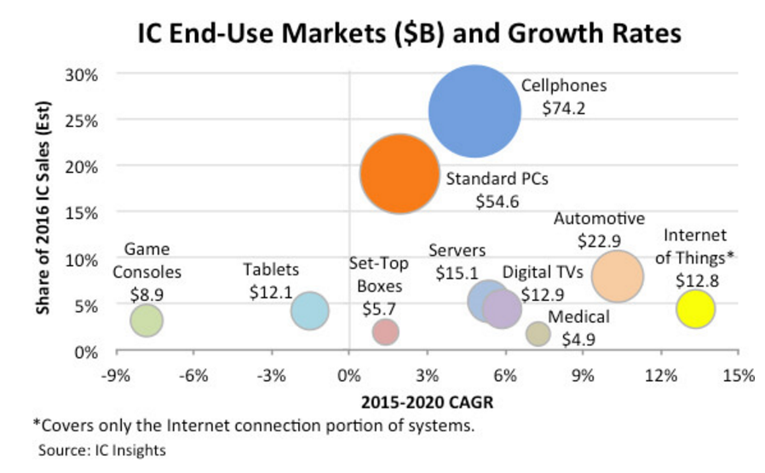
ASIP – Application-Specific Instruction Set Processors

Slide 15
Eight Great Ideas in Computer Architecture
Design for Moore’s Law
Use Abstraction to Simplify Design
Make the Common Case Fast
Performance via Parallelism
Performance via Pipelining
Performance via Prediction
Hierarchy of Memories
Dependability via Redundancy

Slide 16
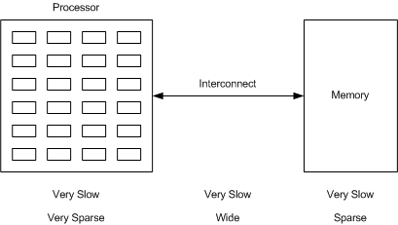
Architecture – Pre 1971
Very low density => simple architecture, few registers, use memory

Slide 17
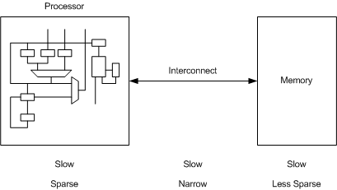
Architecture – 1970s
Integrated, but still very low density, few registers

Slide 18
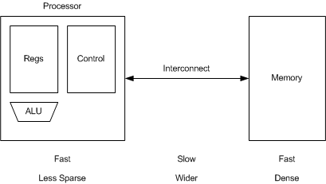
Architecture – 1980s
Registers are much less expensive, so minimize memory accesses

Slide 19
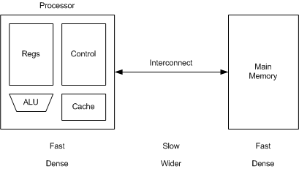
Architecture – 1990s
Add on-board caches – more performance, fewer memory accesses

Slide 20
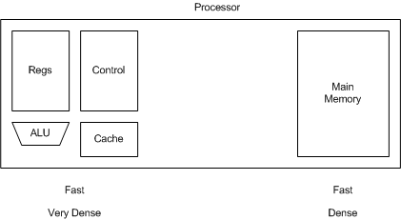
Architecture – Now
Integrate Memory – No interconnect issue
What Great Idea is at work here?

Slide 21
Eight Great Ideas in Computer Architecture
Design for Moore’s Law
Use Abstraction to Simplify Design
Make the Common Case Fast
Performance via Parallelism
Performance via Pipelining
Performance via Prediction
Hierarchy of Memories
Dependability via Redundancy

